Slide 1
Chapter 7 –
Design and Implementation

Slide 2
Design and implementation
Software design and implementation is the stage in the software engineering process at which an executable software system is developed.
Software design and implementation activities are invariably inter-leaved.
Software design is a creative activity in which you identify software components and their relationships, based on a customer’s requirements.
Implementation is the process of realizing the design as a program.

Slide 3
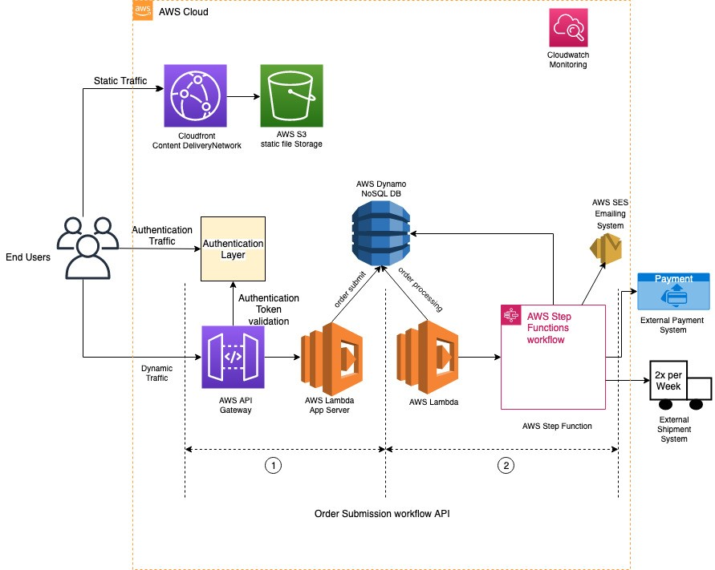
Architecture Example 1

Slide 4
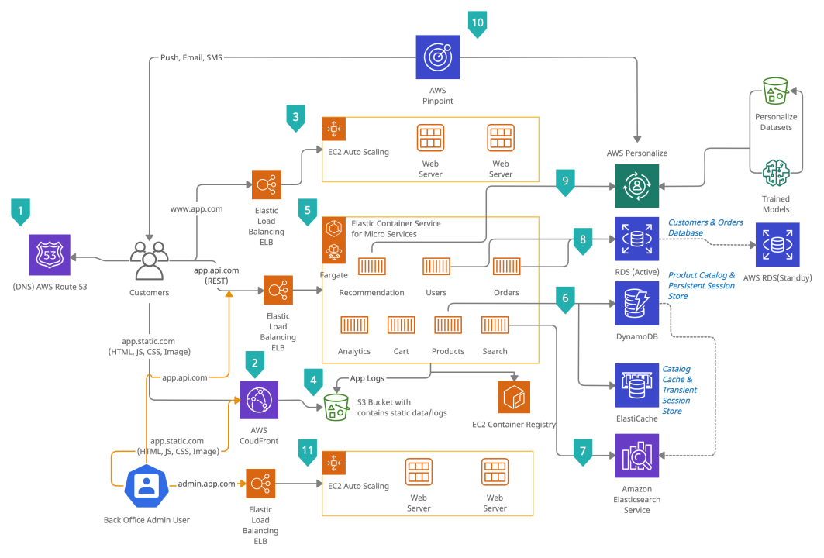
Architecture Example 2

Slide 5
7.2 Design patterns
A design pattern is a way of reusing abstract knowledge about a problem and its solution.
A pattern is a description of the problem and the essence of its solution.
It should be sufficiently abstract to be reused in different settings.
Pattern descriptions usually make use of object-oriented characteristics such as inheritance and polymorphism.

Slide 6
7.2 Pattern elements (continued)
Name
A meaningful pattern identifier.
Problem description.
Solution description.
Not a concrete design but a template for a design solution that can be instantiated in different ways.
Consequences
The results and trade-offs of applying the pattern.
An Observer pattern
Name
Observer.
Description
Separates the display of object state from the object itself.
Problem description
Used when multiple displays of state are needed.
Solution description
See slide with UML description.
Consequences
Optimisations to enhance display performance are impractical.

Slide 7
7.2 The Observer pattern (continued)
Pattern name | Observer
Description | Separates the display of the state of an object from the object itself and allows alternative displays to be provided. When the object state changes, all displays are automatically notified and updated to reflect the change.
Problem description | In many situations, you have to provide multiple displays of state information, such as a graphical display and a tabular display. This pattern may be used in all situations where more than one display format for state information is required and where it is not necessary for the object that maintains the state information to know about the specific display formats used.
Solution description | This involves two abstract objects, Subject and Observer, and two concrete objects, ConcreteSubject and ConcreteObject, which inherit the attributes of the related abstract objects. The abstract objects include general operations that are applicable in all situations. The state to be displayed is maintained in ConcreteSubject, which inherits operations from Subject allowing it to add and remove Observers (each observer corresponds to a display) and to issue a notification when the state has changed. The ConcreteObserver maintains a copy of the state of ConcreteSubject and implements the Update() interface of Observer that allows these copies to be kept in step.
Consequences | The subject only knows the abstract Observer and does not know details of the concrete class. Therefore there is minimal coupling between these objects.

Slide 8
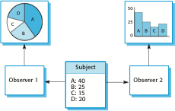
7.2 Multiple displays using the Observer pattern (continued)

Slide 9
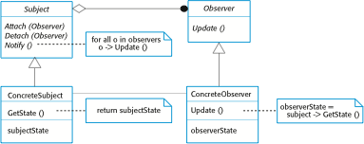
7.2 A UML model of the Observer pattern (continued)

Slide 10
7.2 Design problems (continued)
To use patterns in your design, you need to recognize that any design problem you are facing may have an associated pattern that can be applied.
Tell several objects that the state of some other object has changed (Observer pattern).
Tidy up the interfaces to a number of related objects that have often been developed incrementally (Façade pattern).
Provide a standard way of accessing the elements in a collection, irrespective of how that collection is implemented (Iterator pattern).
Allow for the possibility of extending the functionality of an existing class at run-time (Decorator pattern).

Slide 11
7.3 Implementation issues
Focus here is not on programming, although this is obviously important, but on other implementation issues that are often not covered in programming texts:
Reuse Most modern software is constructed by reusing existing components or systems. When you are developing software, you should make as much use as possible of existing code.
Configuration management During the development process, you have to keep track of the many different versions of each software component in a configuration management system.
Host-target development Production software does not usually execute on the same computer as the software development environment. Rather, you develop it on one computer (the host system) and execute it on a separate computer (the target system).

Slide 12
7.3.1 Reuse
From the 1960s to the 1990s, most new software was developed from scratch, by writing all code in a high-level programming language.
The only significant reuse or software was the reuse of functions and objects in programming language libraries.
Costs and schedule pressure mean that this approach became increasingly unviable, especially for commercial and Internet-based systems.
An approach to development based around the reuse of existing software emerged and is now generally used for business and scientific software.

Slide 13
7.3.1 Reuse levels
The abstraction level
At this level, you don’t reuse software directly but use knowledge of successful abstractions in the design of your software.
The object level
At this level, you directly reuse objects from a library rather than writing the code yourself.
The component level
Components are collections of objects and object classes that you reuse in application systems.
The system level
At this level, you reuse entire application systems.

Slide 14
7.3.1 Reuse costs
The costs of the time spent in looking for software to reuse and assessing whether or not it meets your needs.
Where applicable, the costs of buying the reusable software. For large off-the-shelf systems, these costs can be very high.
The costs of adapting and configuring the reusable software components or systems to reflect the requirements of the system that you are developing.
The costs of integrating reusable software elements with each other (if you are using software from different sources) and with the new code that you have developed.

Slide 15
7.3.2 Configuration management
Configuration management is the name given to the general process of managing a changing software system.
The aim of configuration management is to support the system integration process so that all developers can access the project code and documents in a controlled way, find out what changes have been made, and compile and link components to create a system.
See also Chapter 25.

Slide 16
7.3.2 Configuration management activities
Version management, where support is provided to keep track of the different versions of software components. Version management systems include facilities to coordinate development by several programmers.
System integration, where support is provided to help developers define what versions of components are used to create each version of a system. This description is then used to build a system automatically by compiling and linking the required components.
Problem tracking, where support is provided to allow users to report bugs and other problems, and to allow all developers to see who is working on these problems and when they are fixed.

Slide 17
7.3.3 Host-target development
Most software is developed on one computer (the host), but runs on a separate machine (the target).
More generally, we can talk about a development platform and an execution platform.
A platform is more than just hardware.
It includes the installed operating system plus other supporting software such as a database management system or, for development platforms, an interactive development environment.
Development platform usually has different installed software than execution platform; these platforms may have different architectures.

Slide 18
7.3.3 Development platform tools
An integrated compiler and syntax-directed editing system that allows you to create, edit and compile code.
A language debugging system.
Graphical editing tools, such as tools to edit UML models.
Testing tools, such as Junit that can automatically run a set of tests on a new version of a program.
Project support tools that help you organize the code for different development projects.

Slide 19
7.3.3 Integrated development environments (IDEs)
Software development tools are often grouped to create an integrated development environment (IDE).
An IDE is a set of software tools that supports different aspects of software development, within some common framework and user interface.
IDEs are created to support development in a specific programming language such as Java. The language IDE may be developed specially, or may be an instantiation of a general-purpose IDE, with specific language-support tools.

Slide 20
Design patterns(Cont..)
Design patterns represent the best practices used by experienced object-oriented software developers. Design patterns are solutions to general problems that software developers faced during software development. These solutions were obtained by trial and error by numerous software developers over quite a substantial period of time

Slide 21
What is Gang of Four (GOF)?
In 1994, four authors Erich Gamma, Richard Helm, Ralph Johnson and John Vlissides published a book titled Design Patterns - Elements of Reusable Object-Oriented Software which initiated the concept of Design Pattern in Software development.
These authors are collectively known as Gang of Four (GOF). According to these authors design patterns are primarily based on the following principles of object orientated design.
Program to an interface not an implementation
Favor object composition over inheritance

Slide 22
Usage of Design Pattern
Design Patterns have two main usages in software development.
Common platform for developers
Best Practices

Slide 23
Types of Design Patterns
As per the design pattern reference book Design Patterns - Elements of Reusable Object-Oriented Software , there are 23 design patterns which can be classified in three categories:
Creational
Structural
and Behavioral patterns.

Slide 24
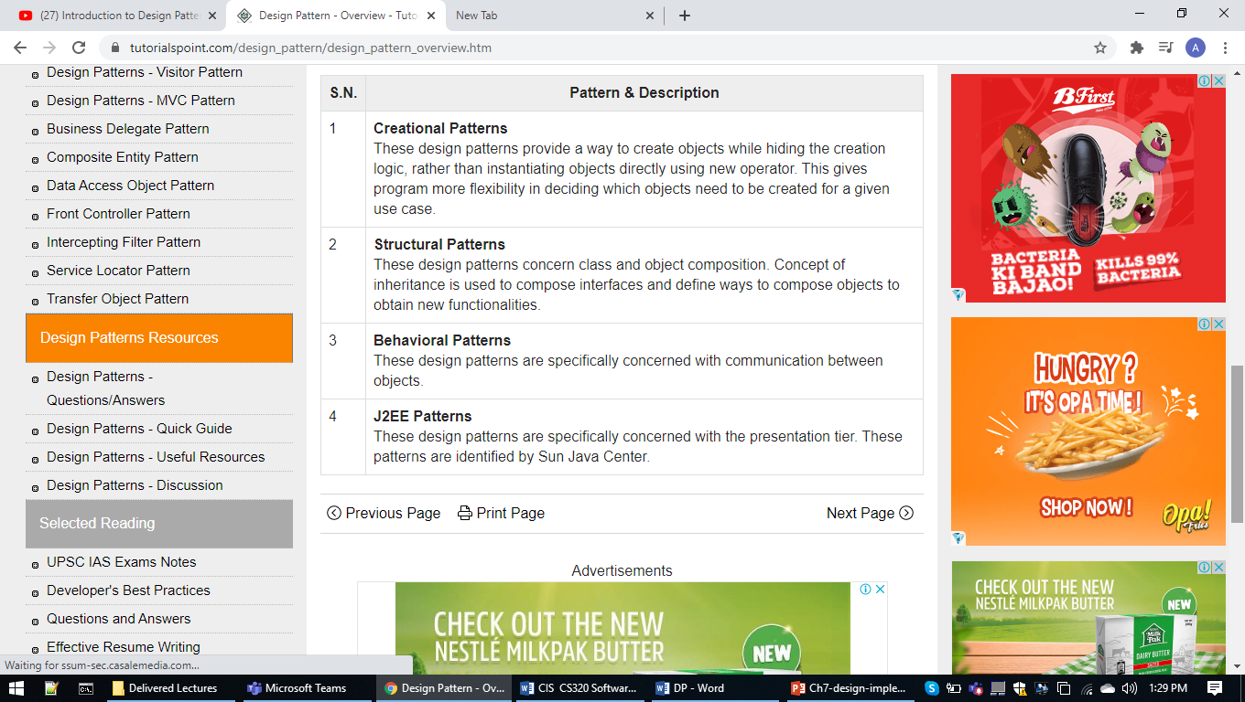

Slide 25
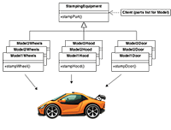
Creational design patterns
These design patterns are all about class instantiation. This pattern can be further divided into class-creation patterns and object-creational patterns. While class-creation patterns use inheritance effectively in the instantiation process, object-creation patterns use delegation effectively to get the job done.

Slide 26
Abstract Factory Creates an instance of several families of classes
Builder Separates object construction from its representation
Factory Method Creates an instance of several derived classes
Object Pool Avoid expensive acquisition and release of resources by recycling objects that are no longer in use
Prototype A fully initialized instance to be copied or cloned
Singleton A class of which only a single instance can exist

Slide 27
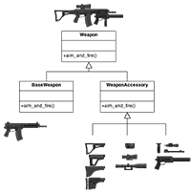
Structural design patterns
These design patterns are all about Class and Object composition. Structural class-creation patterns use inheritance to compose interfaces. Structural object-patterns define ways to compose objects to obtain new functionality.

Slide 28
Adapter Match interfaces of different classes
Bridge Separates an object’s interface from its implementation
Composite A tree structure of simple and composite objects
Decorator Add responsibilities to objects dynamically
Facade A single class that represents an entire subsystem
Flyweight A fine-grained instance used for efficient sharing

Slide 29
Private Class Data Restricts accessor/mutator access
Proxy An object representing another object

Slide 30
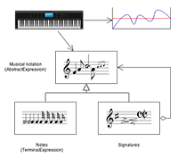
Behavioral design patterns
These design patterns are all about Class's objects communication. Behavioral patterns are those patterns that are most specifically concerned with communication between objects.

Slide 31
Chain of responsibility A way of passing a request between a chain of objects
Command Encapsulate a command request as an object
Interpreter A way to include language elements in a program
Iterator Sequentially access the elements of a collection

Slide 32
Mediator Defines simplified communication between classes
Memento Capture and restore an object's internal state
Null Object Designed to act as a default value of an object
Observer A way of notifying change to a number of classes

Slide 33
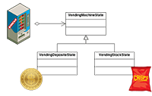
State Alter an object's behavior when its state changes
Strategy Encapsulates an algorithm inside a class

Slide 34
Template method Defer the exact steps of an algorithm to a subclass
Visitor Defines a new operation to a class without change

